Slide 1
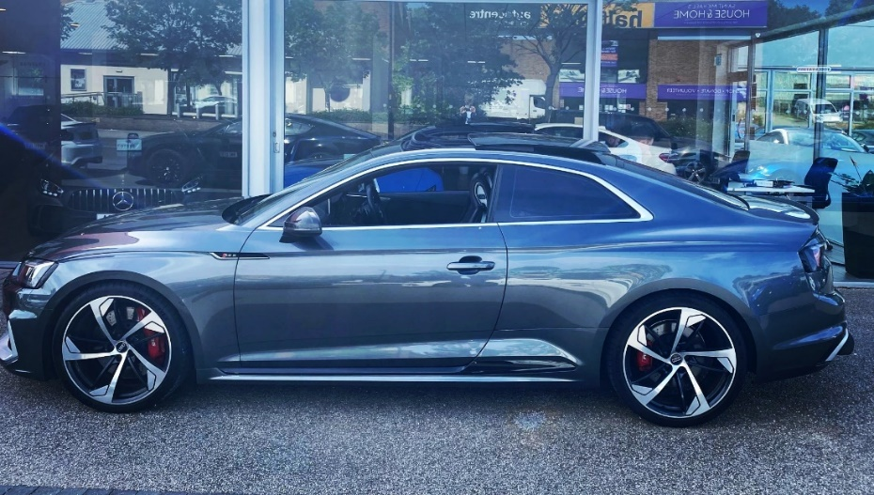
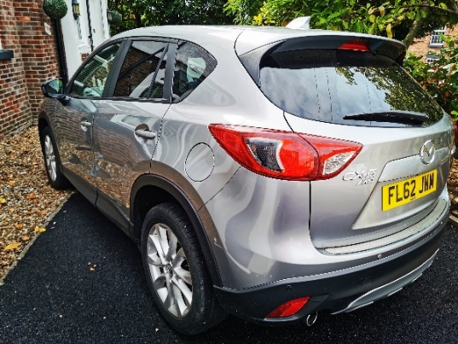
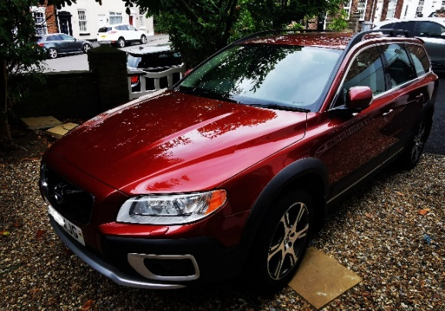
Welcome to: Trader Car Buyer www.tradercarbuyer.co.uk Freedom at your fingertips… From just £499
Owned and promoted by:

Slide 2
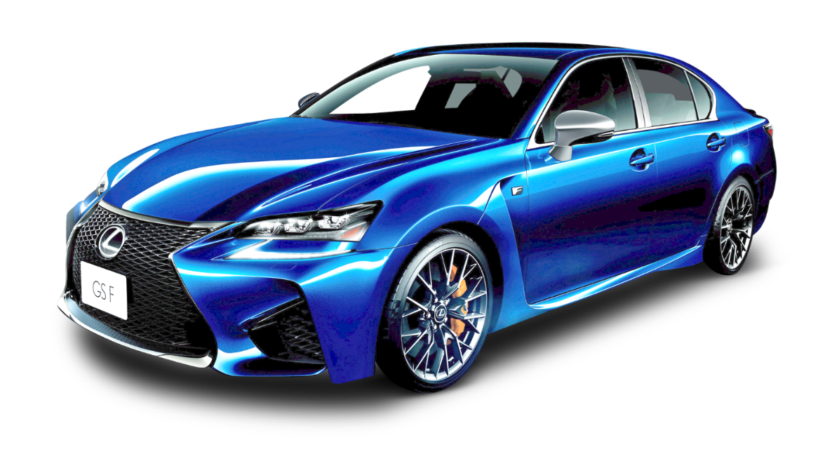
We have an endless supply of trade vehicles from the UK’s leading trade experts with over 30 years experience!
Run your own trade car sales business from home or office!
No experience required, we are here to give you
full guidance with on-going support…
First, watch this short video so you get a basic understanding of what we offer and then read on: https://youtu.be/xxl17qil8cU

Slide 3
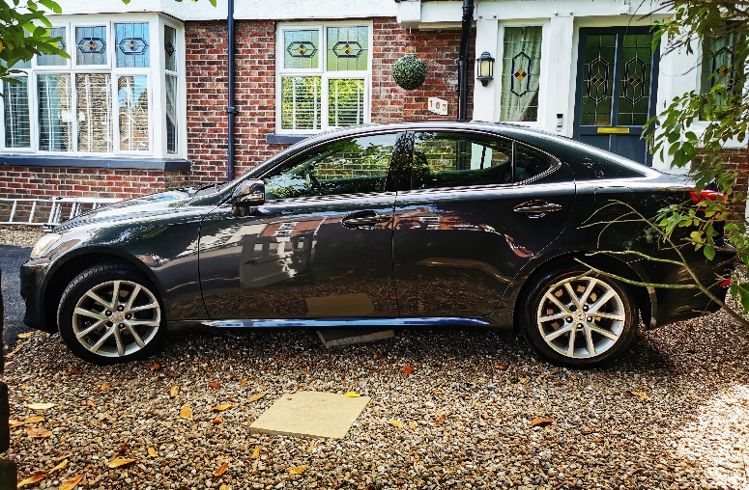
Our Product: Buy our vehicles at trade prices… Or, just sell ours – no funds required!!! 100%, trade vehicles (HPi clear or category cars ) mint condition or they might have just a few marks or dents, all types available, some still with manufactures warranties! Our members simply login to our “members area” to see our vehicles at trade prices! No bidding required | No auctions to deal with | No travelling required| Nationwide delivery/collection will be available at your finger tips… Cars from £500 to Millions!

Slide 4
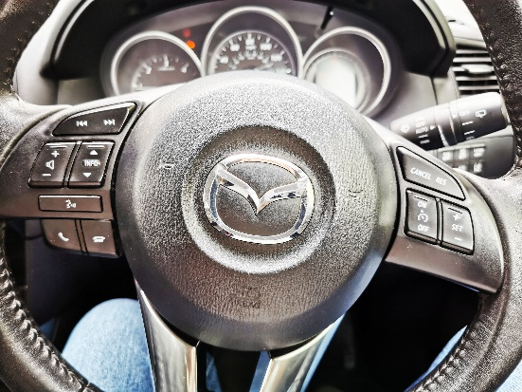
Our Business Model: Working from home or anywhere you chose! You’ll be able to purchase these vehicles direct from us at trade prices, from just £500, whenever you wish. No bidding is required or complicated auctions to deal with, just say you want it and follow our instructions. We offer detailed instructions and on-going support and guidance, so no experience is required, but the love of cars is helpful. We inspect all our vehicles and give a detailed description of the condition and if it has any known issues. You can even request a walk-around video of the vehicle you are interested in, this saves time, so no travelling is needed. Cars are available everyday, with new ones been added all the time. So, as and when you are ready, simply visit our app and check out what’s on offer. If you are looking for a certain type of vehicle, simply message us direct as a member, tells us what you want and we’ll search our massive data base to find that vehicle…

Slide 5
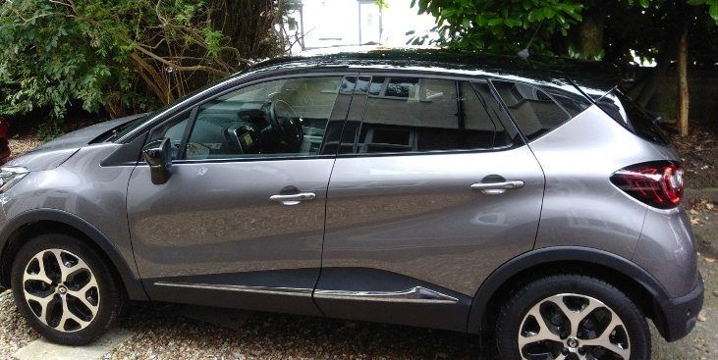
Example of your profit margins for a typical car
Dated 10.06.2024
To view examples of recently sold vehicles
Click on our Facebook icon
Here is an example of just one of our cars that recently sold, so you can see yourself, how the profit margins work!
2020 (70) Renault Captur 1.5 dci GT Line (only 15,350 miles) Top of the line, heated leather seats, sat nav, etc! 100% HPi Clear.
Retail price at the time: £11,5950.00 Our price was just £8,495 to our member.
Max profit retail: £3,100.00 | Private sale: £2,000.00 | Trade sale: £905.00
It was sold for £11,000 and our member made £2,505 profit…

Slide 6
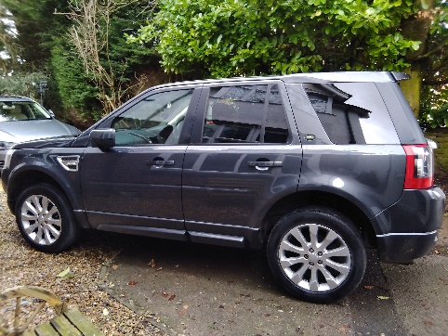
Example of your profit margins on a trade car - Hpi clear - dated 20.06.2024
To see more examples of previously sold vehicles
Visit: https://www.tradercarbuyer.co.uk/
Or,
Here is an example of just one of our trade cars, so you can see yourself how the profit margins work!
2011 (11) Landrover Freelander 2.2 Sport LE - Leather seats, full electrics, FSH, loads of bills, etc! 100% HPi Clear in great condition.
The wheels needed refurbish, headlights polished and a good clean – Our member did this themselves, as he also purchased our “smart package”. This took him 4 hours and saved £300 if he had paid someone else to do it…
Retail price at the time: £4,995.00
Our price £2,495.
Members Profit: £2,500.00

Slide 7
Work in your spare time – Earn £10,000 per month! This is not pie in the sky earnings, our current members are earning this and much more.
Just selling 4 cars a month, average profit of £2,000.00 per car
2 cars = £4,000.00
4 cars = £8,000.00
So, you can see, there is massive potential here, we do it every day!
Literally, just a few hours is all it takes on your part, as we do the hard work for you, finding and supplying the cars!
You can sell cars within hours!
As a member, we are here to support you every step, to ensure you don’t make the mistakes that in-experienced people make everyday!
One of our members reported selling a car on Facebook Market Place in just 50 minutes and made £1,200 profit
With our help and guidance, you’re on your way to freedom…
Testimonial from one of our members:
Thank you guys! My life has changed so much. I was lost and didn’t know what I was going to do after losing my job. You have helped me into a business I love and I’m making some serious money.
I sold a Nissan Elgrand recently for £10,250 after only paying £6,700 for it, making a fantastic profit of £3,550. My total this month is £8,870 so far and still a week to go.
I will highly recommend you guys anytime, my future is set now and I’m a better person for it.
Respect Scott Harvey

Slide 8
Broker Our Cars!
What is a Broker?
A broker is a person who acts on behalf of a company selling, and a company or person buying. The broker introduces them to each other, to successfully complete a deal and then the broker receives a commission for doing so.
You don’t have to buy our cars, if you do not wish too, just broker them!
Maybe you don’t have the funds to actually buy, or maybe, you just don’t have room to keep the car until you sell it? Whatever your reason, this does not stop you becoming involved in this very lucrative business!
Become one of our Car Brokers!
Buy or broker our cars, its all the same to us, as we make our money from selling our cars! So, unlike a franchise, we do not need to charge any on-going fees, whatsoever!
Broker continues on the next page:

Slide 9
Our Broker Business Model
You can broker, (Sell our cars), if you don’t have the funds or don’t wish to purchase them, yourself! Ideally, do both!
So, apart from the joining fee, there are no other costs involved.
You’ll have access to our list of cars and other items at the trade prices we need for them. You simply add on your required mark up. So, if we are asking £5000 trade money, you add on the commission you require. We can guide you on the right price for a quick sale. As a broker, you can easily broker 5 cars in a day and make thousands. Imagine if you sold a few of our more expensive cars… Thousands can be made with just one sale. We offer the following:
Trade cars from £500 | Super-Cars | Hyper-Cars | Hi-End Watches | Motorcycles
You’ll have enough details in our app that’s needed to find “potential buyers” and full instructions on how to do this. Don’t forget family and friends to help spread the word and using Facebook business pages. Email local garages as the are always looking for new stock. All vehicles must be sold at trade prices, unless you actually buy the vehicle yourself, then you can sell at any price you see fit ,with our guidance.
Simply offer our cars, super and hyper-cars, hi end watches, even motorbikes and build up your contacts to create your own, successful brokerage. As your list of buyers grows, simply add them to your own WhatsApp Business and list our vehicles for everyone to see at once.
We’ll help you gain trade buying customers with full instructions and guidance using our 30 years plus, experience
When you get a customers that’s interested, just pass the enquiry to us and we do the rest for you!
All commissions due are paid out weekly, every Friday and we never claw back any commissions paid!

Slide 10
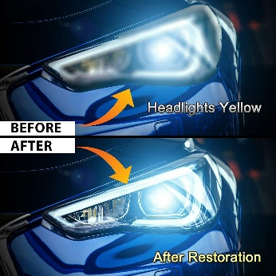
We even include our Smart Repair video’s
If you don’t mind getting your hands dirty and enjoy the hands on approach, then our Smart Repair is for you! It’s a great addition and totally free as part of our package.
Most second hand cars will have cosmetic issues, alloy wheel refurbishment, smart paint repair, leather repair, headlight restoration, plastic trim repair and even brake calliper painting is very popular.
This way you’ll be able to make those repairs yourself, easily and this will save you a small fortune paying others to do it for you! Most cars will need their wheels touching up and a few paint scratches, etc. It will save you on average £300-£400 per vehicle doing this yourself, which means an extra £300-£400 in your pocket.
Also, why not repair your family and friends cars in-between selling your own cars and make up-to £100 per hour. A free advert on Facebook works a treat!
We’ll supply full details in video form for easy learning and before long, you’ll be a pro! Practice your new skills on your own car or family and friends…

Slide 11
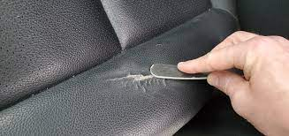
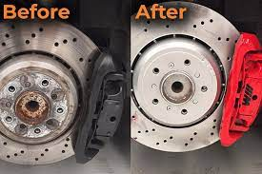
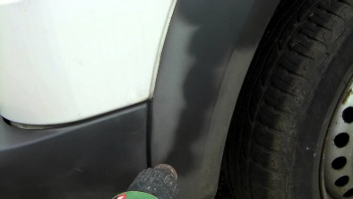
Optional Website: £299 (Not included in our packages)
Option extra: If you are thinking of doing the Smart Repairs, it’s a good idea to have a professional website to promote your services and show people how professional you are.
Fully designed website to promote your services, professionally. Domain name included. £249
Includes;
Local SEO on Google to help people find you and 30 days advertising to at least 3,000 people to boost your site and help
give you the best start possible.

Slide 12
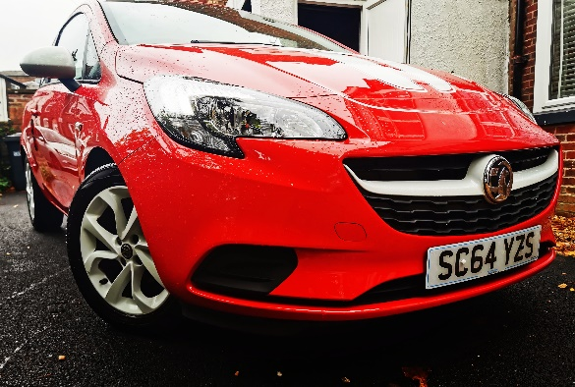
Questions & Answers
(Q) How can you offer this service, when your competitors charge thousands of pounds?
We make our money from actually selling our own cars – not by signing up members. Our joining fees are just to cover our set-up costs and to encourage genuine members. The more cars we sell and the more profit we all make.
(Q) How many cars will I have to chose from?
We will always have plenty of cars to offer you, more than you will ever buy – you’ll have access to literally hundreds per week.
(Q) I don’t know much about cars?
That’s where we come in. Over 30 years experience at your finger tips, so do not worry about that. We do the hard part by obtaining the vehicles for you. The love of cars is all you need.
(Q) How long before I’m up and running?
Literally 24 hrs. We can even hand pick a car to offer you, when you join! One that’s a nice and easy 1st car to help you get off to a good start. Let’s get that 1st sale under your belt to boost your confidence and your wallet!
(Q) Do I have to buy the cars?
No, you can just broker (Sell) our cars if the funds to buy are not available or, for whatever reason, you don’t wish to actually
buy our cars. Its up to you. Buy one car, no cars or 10 cars, its your decision. There is no pressure from us.

Slide 13
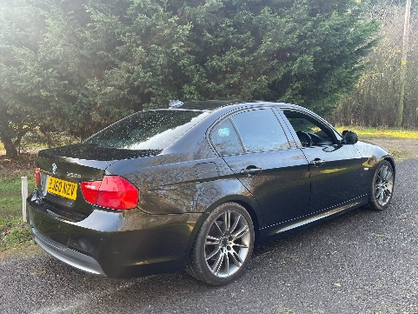
Questions & Answers con’t
(Q) Is this an actual franchise business or are you just offering a package where someone can have access to your range of vehicle
stock and other benefits as part of the package?
This is a business opportunity but yet, very much like a franchise, as we offer full back up and support but without the high joining costs and there are no on-goings fees, whatsoever!
(Q) The £695 fee to join – is this a one off or yearly fee?
It’s a one of fee! We make our on-going profits from selling cars to our members or, our members brokering our cars, not from charging on-going fees.
(Q) Am I correct in assuming you are not asking for a yearly franchise fee and commission per vehicle I sell?
(A) Yes, you are correct, as above, just a one off joining fee and we make our money selling cars. Whatever you sell the car for, is
all yours.
(Q) Do I have to register my self as a car trader to buy a car at trade price from you?
No, we recommend you start small, buying just one or two cars to start with and build from there. We will advise you along the way if you wish to grow into a larger business.

Slide 14
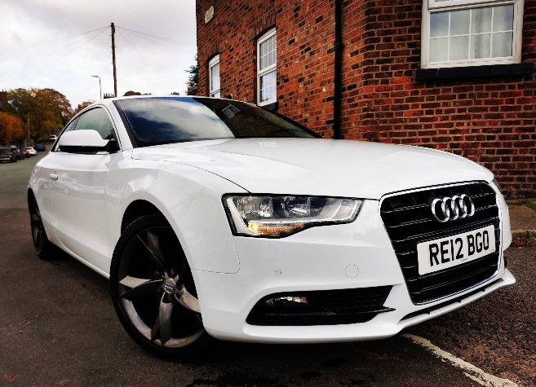
Our full trader package, includes the following: £695
Access to our members only trade vehicles from £500 to Millions.
Access to hundreds of vehicles weekly from across the UK. Buy cars near you!
Full broker access to sell our cars without even buying them!
Smart repair instructions and videos to save/make even more money
One to one mentoring from your own guru.
Access to trade buying apps. We’ll show you how to sell your cars direct to trade. Sell 10 cars in a day!
Vehicles supplied to you at trade prices, no bidding!
Full description of each vehicle with clear photos and walk-around video supplied
Access to HPi reports
MOT App’s, valuation reports, everything you need to do your homework on each vehicle with full guidance.
We’ll show retail, private selling price and potential profits.
We’ll help to arrange your Trade Insurance at the best prices to drive all cars, even your own private car(s) included, so all under one package. (Not required)
Help with Banking, invoicing, terms and conditions
On-going support and guidance, including how to prepare vehicles, sell, etc
Nationwide delivery/collection of your vehicle to your door from £1 per mile, plus fuel.
Everything we have learnt in the last 30 years will be at your disposal to ensure success!
Join us now and we’ll help you earn £10,000 per month, plus!

Slide 15
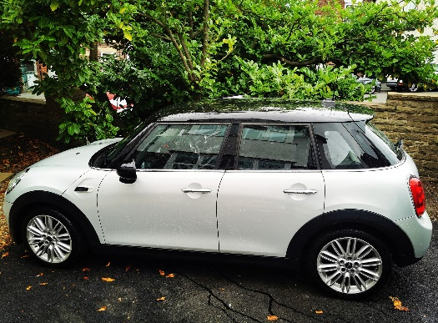
Broker Only Package £499
Access to our members only trade vehicles from £500 to Millions.
Full broker access to sell our cars without even buying them!
Full description of each vehicle with clear photos.
Full back office support (We do all the paperwork and complete the sales for you).
Full instructions.
Commission paid weekly and no clawbacks, ever!
On-going support and guidance from your own guru.
Everything we have learnt in the last 30 years will be at your disposal to ensure success!
Join us now and we’ll help you earn £10,000 per month, plus!

Slide 16
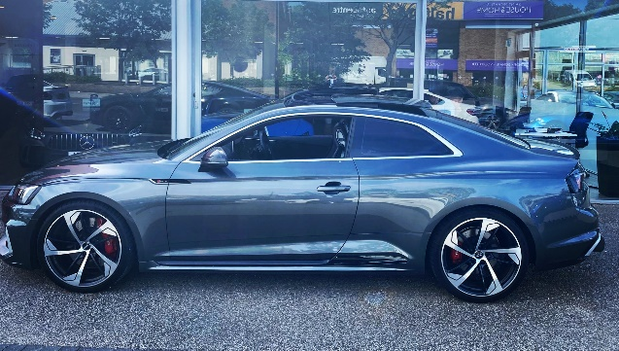
In a nut shell…
We offer a full trade car buying/selling package, from a business with over 30 years experience in the industry!
Buy and sell our cars from £500. Access to our members area only app
Easily earn £10,000 per month using our proven system
Buy cars from other recommended sellers if you wish
Broker our cars without buying them, or do both, the choice is yours
Smart repair videos and instructions. Make your own repairs
One to one mentoring
Videos of all our vehicles you wish to buy, descriptions and reports
On-going support for as long as you need
Optional website

Slide 17
If you would like to discuss our opportunity in more detail, or have any questions? Please contact; Emma Slater to arrange a call meeting: Email her at: sales@clpromotions.net
If you wish to join, simply email us at: sales@clpromotions.net
We will then forward you an invoice and instructions!
Tel: 01625 501596
Owned & Promoted by:

